Slide 1
Machine Learning
Final Project-Topic Detail
陳昕佑 (Hsin Yu Chen)
61375017H

Slide 2
Research Purpose
My Master’s Degree research topic is the application and safety of collaborative manipulator, and I'm going to use vision detection to detect objects.
Imagine a human-robot collaborative work environment, while a human asks the robot to pick a specific tool and give it to a human, the robot needs to label the tools in the environment and identify the correct tool to choose. To do that, using image recognition is the direct way that we can use machine learning to train a model and run it in real-time.

Slide 3
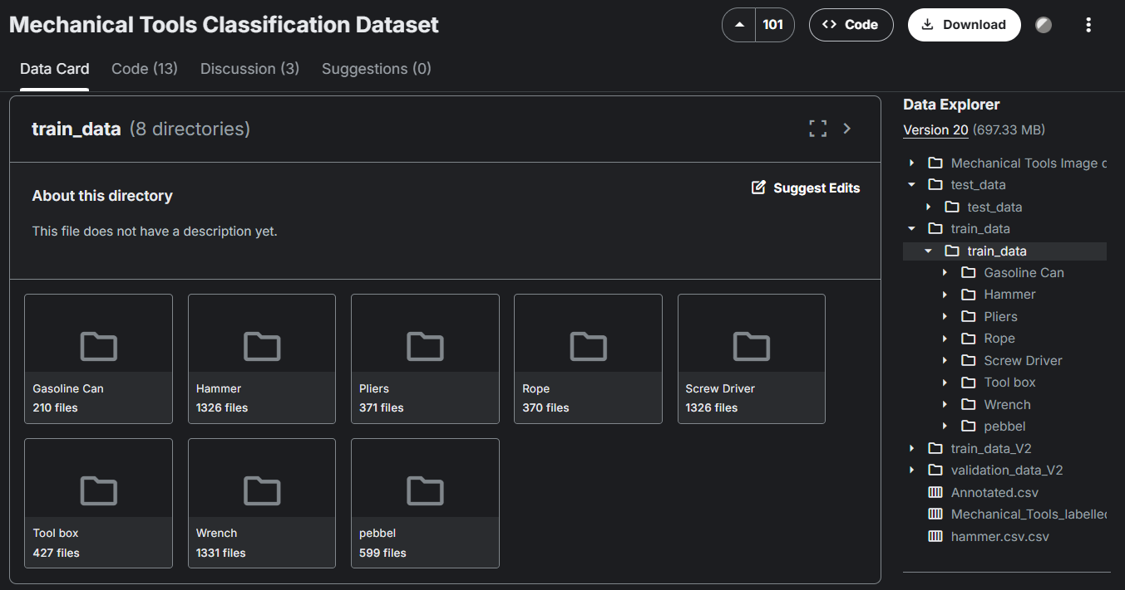
Research Method
I picked a dataset called “Mechanical Tools Classification Dataset” from Kaggle with 8 kinds of tools’ images. I’m going to use CNN or other models to train and predict the input image, then compare the performance and accuracy.

Slide 4
Thanks

